Slide 1

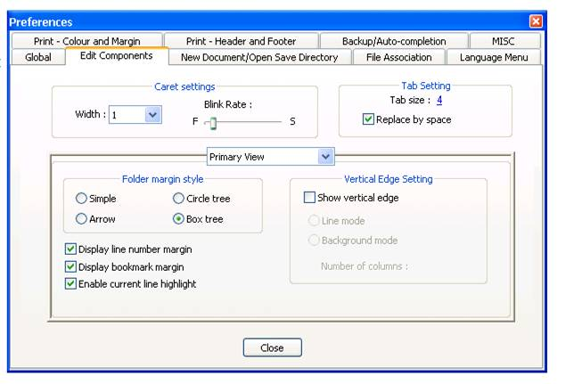
Notepad ++ setting to replace tabs with spaces
DSM2 Cool Tip

